Slide 1
Social Prescribing for IMG GP Trainees, Nurses, Midwives and AHP’s
Health Education England Social Prescribing Team
Humber Teaching NHS Foundation Trust
Produced by Paula Baldry

Slide 2
Hello & Welcome
Introduction
The offer
The support
ONS4 wellbeing scale
Access

Slide 3
Let me introduce myself
Paula Baldry
Worked in the NHS for 2 years
Previously worked for HMP Prison Service and the local authority
Moved to Humber Trust and have been offered the opportunity to start this brand-new Social Prescribing service, specifically for IMG GP trainees, Nurses, Midwives and A.H.Ps. I cover Buckingham Health Trust and Thames Valley Trust
The only service of its type in the country

Slide 4
YOURhealth Social Prescribing Service
We have been delivering the social prescribing service in the East Riding for the last 5 years and engaged with over 25,000 patients in this time
within this we cover,
Individualised care and motivation
Social, emotional or practical needs
Examples include social isolation, welfare support, emotional wellbeing

Slide 5
What is the offer?
1 to 1 appointments for trainees (and their families) who are aligned to Buckingham health Trust and Thames valley Trust training schemes
A confidential, safe space to talk
We like see it as talking to a friend!

Slide 6
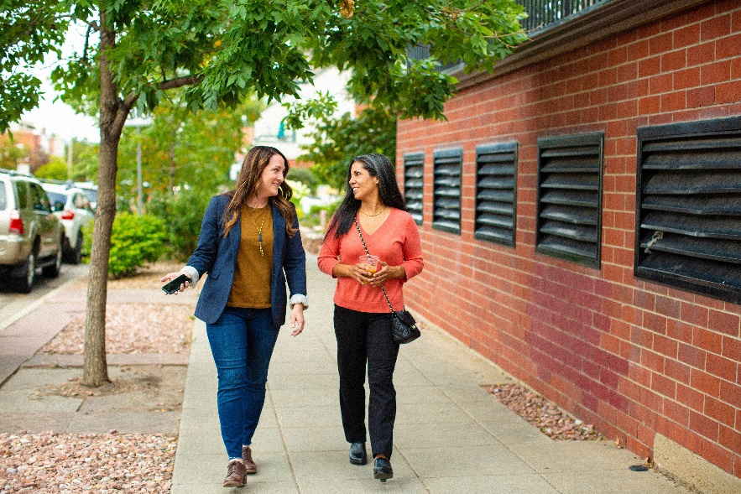
What is the offer?
Any area that is affecting their wellbeing that is a non-medical issue but is affecting your ability to self-care and stay well
Co-produced therapeutic plan – we work together
Signposting service
For Trainees and their dependents

Slide 7
What support can we provide?
Emotional & wellbeing support
Community connections / isolation / integration
Housing
Schooling and nurseries
Access to driving lessons
Financial concerns
Low level mental health support
Training progression & exam support

Slide 8
ONS4 questions and our referral form
Tool | What is it? | Why should it be used? | Who should it be used with? | How often should it be used?
ONS Wellbeing Scale | Four short questions (ONS4) on life satisfaction, how worthwhile they feel their life is, happiness and anxiety levels. | ONS4 is a free nationally validated wellbeing scale, based on the person’s own views. | Everyone who is referred to the social prescribing service. | When the person is initially referred to social prescribing and at least every 6 months, for one year.
We use SystmOne for our appointments, so will need to access your record to set up appointments and to record notes about any support we provide. We have no reason to access your GP record, so this would only be for me to make notes against your record and to send a text to confirm your appointments.

Slide 9
Testimonials
I am thankful for your quick and detailed replies, that really helped me when I was confused about where to get the right information.
Please accept my heartfelt gratitude for the exceptional social prescribing service you provided to me on behalf of the Thames Valley GP school.
Thank you for your quick and warm response to my request for support in finding accommodation in Milton Keynes. Specifically, for taking the time to speak with me to understand my needs and preferences regarding location and budget.
As someone who has never been to Milton Keynes, it was important to me to find the right accommodation in a safe and comfortable environment. Thanks to your recommendation on letting websites and which areas to live in, I’ve been able to find a lovely place to call home when I start training in August.
Once again, accept my deepest appreciation. I look forward to speaking to you again.
Dear Paula
Thank you for all your support for our trainees. You are providing a hugely valuable service. Amazing work.
Dear Paula,
Thank you for your email and especially for sharing this wonderful quote with me at this time. I found it very inspiring.

Slide 10
Testimonials
“I would encourage every trainee to use this if they feel they need help.’
“…my social prescriber had a compassionate, non-judgemental and gentle approach, which I found relaxing and reassuring…”
“I definitely recommend them to everyone, especially if you are new to a training area and need some support with what's most likely a massive change for you."

Slide 11
How you can help?
Don’t be afraid to email me to ask if I can help/support
As a line manager offer the service if you feel support is required
Complete the referral form and send it to me
Have sight of the flyers that we have produced

Slide 16
How do I get in touch?
They can self-refer into the service, or you can refer as an Educator/Line Manger
By email hnf-tr.heesocialprescribing@nhs.net
By telephone 0800 9177752
Email for trainers only paula.baldry@nhs.net

